Slide 1
ADHD - Practical Strategies to Managing Behaviour Workshop
Dr Sonia Bailey
Educational Psychologist
With thanks to ADDitude

Slide 2
Agenda
Provide Information around identifying the main ADHD behaviours.
Include practical tips for implementing strategies.
Learn how the strategies will help manage behaviour.
Provide an opportunity to ask questions and discuss ADHD behavioural issues being experienced.

Slide 3
ADHD is a Superpower
https://www.bbc.co.uk/news/av/stories-47630021
Reframing ADHD
Easily distracted | Has high levels of awareness and observation
Restless | Energetic and lively
Goes off at a tangent. | Individualistic and independent.
Forgetful. | Absorbed in their own thoughts.
Interrupts others. | Enthusiastic about contributing.
Untidy work | Look for signs of effort despite difficulties.
Selfish | Single-minded in pursuit of goals.
This is a growth mindset approach that may help to maintain a positive relationship with children with ADHD.

Slide 4

Some Positives Associated with ADHD
Able to adapt quickly to changed circumstances
Creative
Divergent thinker
Good at individual sporting activities
Good leader in team games
Good at visual thinking
Highly aware of the environment around him/her
Highly questioning
Highly independent
Highly flexible
Imaginative
Innovative
Inquisitive
Keen to take part and contribute
Perfectionist
Persistence
Sensitive
Sharp observational skills
Tremendous energy
Unusual outlook
When motivated can respond very well and with great energy
When motivated can change strategies very quickly
Willing to take risks

Slide 5
ADHD: The Most Common Neurodevelopmental Condition of Childhood
Brain-based, neurodevelopmental disorder
• Brain imaging studies show:
–Smaller volumes in specific brain regions
–Impaired neurotransmitter activity
• Studies show a strong hereditary component
• Characterized by inattention and/or impulsivity, hyperactivity
–significantly impacts behaviour and performance

Slide 6
Definition
DSM – 5 (2013)
A persistent pattern of inattention and/or hyperactivity-impulsivity that interferes with functioning or development, as characterised by at least 6 out of 9 inattention symptoms and /or at least 6 out of 9 hyperactivity and impulsivity symptoms.
Several inattentive or hyperactive-impulsive symptoms were present prior to age 12 years.
Several inattentive or hyperactive-impulsive symptoms are present in two or more settings (e.g. home and school).
There is clear evidence that the symptoms interfere with, or reduce, the quality of social, academic, or every day functioning. (Also, in NICE guidelines 2018)
The symptoms…. are not better explained by another mental disorder (e.g. mood disorder, anxiety disorder).

Slide 7
DSM-5
ADHD categories:
Combined presentation
Predominantly inattentive presentation
Predominantly hyperactive-impulsive presentation
No longer described as subtypes
Severity:
Clinicians required to specify severity level of an individual’s ADHD: mild, moderate, severe
Typical diagnosis around 7, 8, 9 years.
Affects 0.9% girls and 3.6% boys between 5 and 15 years of age (NICE, 2013).

Slide 8
Recognising ADHD in Educational Settings
NICE Guidelines (2018):
If the CYP’s difficulties that are suggestive of ADHD are having an adverse impact on their development or family life, consider:
A period of watchful waiting of up to 10 weeks
Offering parents/carers a referral to group-based ADHD-focused support (not dependent on formal diagnosis).
If persistence of at least moderate impairment, referral to the Paediatrician for assessment is recommended.
If thought to be severe impairment, referral should be made directly to the Paediatrician (or other secondary care) for assessment.

Slide 9

NICE Recommendations 2018 – Supporting children and young people with ADHD
ADHD-focused group parent-training programme to parents/carers as first-line of treatment.
Environmental modifications to be implemented and reviewed.
Consideration of a course of cognitive behavioural therapy (CBT) for CYP with ADHD who have benefited from medication but whose symptoms continue to cause significant difficulties in more than one environment.
When there is transition to a new setting further advice on environmental modifications within the educational placement may be provided by a professional.

Slide 10
Use sparingly
Consequences for misbehaviour
Behaviour plans and reward systems
Give good directions
Positive attending and active ignoring
Setting the stage for success
Start here and use frequently

Slide 11
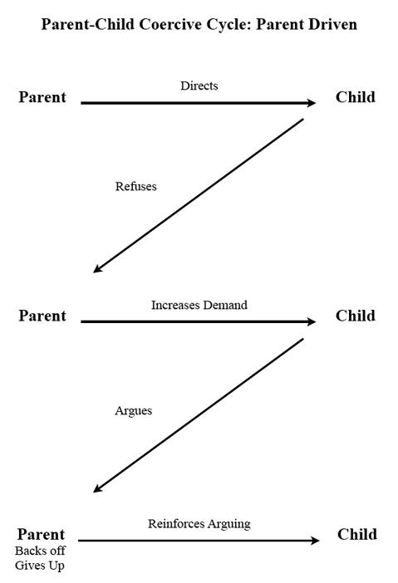
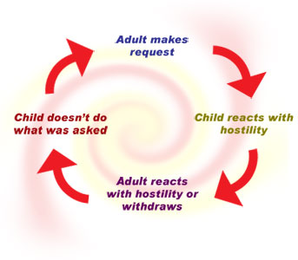
Behaviour: The Coercive Cycle

Slide 12

A Key Step: Strengthening Your Relationship
The goal is to pull you out of the coercive cycle and help you enjoy being with your child again
Establishing a warm relationship with your child is putting “money in the bank” and will make setting expectations much easier.

Slide 13

Quality Time
Pick an enjoyable activity for your child
Ask your child what they would like to do
Be present in their experience
Follow their lead
Focus on giving attention to positive behaviours
Avoid directions, questions, and critical statements
Cultivate common interests and interaction routines.

Slide 14
Honour the Brain’s Needs:
Predictability
Consistency
Ordered structure
Organised spaces
Motivation
Stimulation

Slide 15
Examples of Routine Systems

Slide 16
Use sparingly
Consequences for misbehaviour
Behaviour plans and reward systems
Give good directions
Positive attending and active ignoring
Setting the stage for success
Start here and use frequently

Slide 17
Specific Praise for Positive Behaviours
• Be Specific*
• Be Consistent
• Be Sincere
• Occurs immediately after the behaviour
• Occurs when you are physically close
• Use non-verbal re-inforcers
• Use at a high dose (3:1 ratio)
• Focus on behaviours you want to increase
“Well done for finishing your work!”

Slide 18

Planned Ignoring
Withdraw attention for minor misbehaviour and immediately provide reinforcement (praise) for positive behaviour.
Behaviours appropriate for withdrawal of attention
Complaining
Arguing
Interrupting.

Slide 19
Use sparingly
Consequences for misbehaviour
Behaviour plans and reward systems
Give good directions
Positive attending and active ignoring
Setting the stage for success
Start here and use frequently

Slide 20

Giving Effective Instructions
Stay calm. It models appropriate behaviour and prevents raising your voice.
Be clear and straightforward. “Please go and get your coat,” not, “Can you go and get your coat?”
Give instructions one at a time. A series is harder to remember.
Wait for follow-through. Catch it with praise.
Avoid “no,” “stop,” and “don’t.” Say what you want your child to do.

Slide 21
Schoolwork Coaching
Behaviour | Coaching Statement / Specific Praise
Concentrating / Focusing | “You are so focused on your reading.”
Following Directions | “You read those directions really carefully before starting on your worksheet.”
Paying Attention | “I could see that you were really listening to me when I gave you those instructions.”
Best Work | “You worked hard to give really good answers to those questions.”
Independence | “You worked that out all by yourself.”

Slide 22

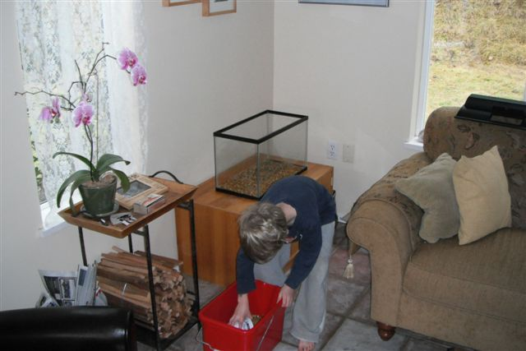
Coaching Statements
Think of one coaching statement / specific praise for each image…

Slide 23
Facilitating Persistence – 5 P’s
Praise – lead with past successes
Predict – make a positive prediction
Prompt – Break tasks down, start with the easy stuff; reinforce small steps towards the goal
Patience
Practice

Slide 24
Coaching Statements
Now turn your coaching statement into ‘praise, predict and prompt’ (3 P’s) …

Slide 25
Use sparingly
Consequences for misbehaviour
Behaviour plans and reward systems
Give good directions
Positive attending and active ignoring
Setting the stage for success
Start here and use frequently

Slide 26
Behavioural Intervention
What is the behaviour?
–Define behaviours in specific, observable & measurable terms
When does it take place?
Where does it take place?
With Whom does it take place?
Why does it take place (i.e., what’s the function of the behaviour)?
–Sensory
–Escape
–Attention
–Tangible

Slide 27
ABC Chart – Antecedents Behaviour Consequences
Date/Time | Activity | Antecedent | Behavior | Consequence
Date/Time when the behaviour occurred | What activity was going on when the behaviour occurred | What happened right before the behaviour that may have triggered the behaviour | What the behaviour looked like | What happened after the behaviour, or as a result of the behaviour
4Monday 15th March at 5 pm | Tidying up | Asked Stacey to tidy up | Stacey swept the toys off the table. | I sent her to her room
Activity: This of the most recent event that led to the behaviour of concern. Fill in one row of the chart for this event.

Slide 28
Behaviour Plan Implementation
Monitor and define target skills/behaviours
Focus on 1-3 specific target behaviours at a time
Positively phrased (what to do)
Get specific
Examples:
Get started on schoolwork right away
Focus on lessons for 30 minutes
Stay calm and ask for help when needed
Develop a reward menu
Co-create with your child
Notes:
.

Slide 29
Sample Home-Based Behaviour Chart - Younger Child (3-6 years)
Work out what you would like to see instead.

Slide 30
Sample Home-Based Behaviour Chart - Older Child (6 years +)

Slide 31
Points System (Ages 12-15)
Date | Item | Deposits | Withdrawals | Balance
01/02/20 | Completed work without parent reminders | 200 |  | 200
01/02/20 | Tidied room | 400 |  | 600
01/02/20 | 30 mins of Xbox time |  | 200 | 400
Make a list of rewards and privileges; include everyday and special privileges (at least 10 total)
Make a list of jobs/responsibilities and activities your child has difficulty completing (range 100 to 1000 points)
Barkley & Robin, 2014

Slide 32
Reward and Consequence-Based Behavioural Management
•Consequence based
–Identify desired alternative behaviour
–Reward alternative behaviour (points, etc)
–Withdraw privilege/points for negative behaviour
•Reward based
–Rehearse desired behaviour when calm
–Remind and praise/reward gradual improvement
•Problem-solving (empowerment) based
–Identify goal
–Alternative means of achieving goal

Slide 33
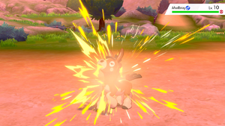
Principles for Children and Adults
Focus on one issue first
Normative versus extreme levels
Anticipate and plan for situations
–Triggers tend to be recurrent
Warmth and consistency
–But identify and avoid “secondary gain”

Slide 34
Use sparingly
Consequences for misbehaviour
Behaviour plans and reward systems
Give good directions
Positive attending and active ignoring
Setting the stage for success
Start here and use frequently

Slide 35
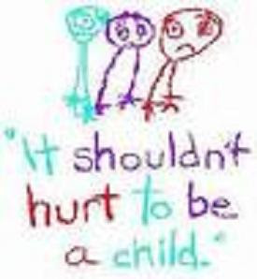
Guidelines for Consequences for Misbehaviour
Why harsh punishments are ineffective:
Only have short-term success
Increase emotional reaction from your child
Deteriorates quality of parent-child interaction
Teaches child what NOT to do; it does not TEACH
appropriate behaviour

Slide 36
Guidelines for Consequences for Misbehaviour
Establish your consequence plan in advance
Administer the consequence in a neutral and calm voice
Use sparingly
Administer immediately after the behaviour occurs
Give consequences in small doses; let the medicine do the work!
Remember to reset after delivering a consequence
Be consistent – if you say it, follow through
Remember to continue implementation of positive behaviour management strategies!

Slide 37
Emotional Dysregulation
Can’t control own emotions
A form of communication
General emotional dysregulation
–struggling to adapt/match their emotional intensity to the situation
Emotional intensity
–people with ADHD experience emotions more intensely
–teens experience emotions more intensely
Difficulty recognising & identifying emotions
–their own emotions
–other people’s emotions and the ability to identify them
Over-sensitive
Temper tantrum
anger

Slide 38
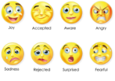
Emotional Dysregulation
Moods
rapid, often exaggerated changes in mood
strong emotions/feelings (uncontrollable laughing or crying, powerful irritability/temper)
sometimes expressed through behaviours that seem exaggerated compared to the situation
Irritableness
general negative feelings
anger (sometimes displaced)

Slide 39
Emotional Dysregulation
>>> Dysregulated is dysregulated, regardless of the emotion.<<<
You know their baseline. Look for deviations from the norm:
More movement than usual (pacing, fidgeting, hand-wringing, etc…)
Larger expressions of emotion (yelling, large physical gestures, hiding in their room or under a blanket, grabbing for emphasis, swearing)
Uncontrolled emotions (laughter, crying, punching things)
Smaller gestures (they flip their hood up, they ask/tell you to stop, they shut down or withdraw).

Slide 40
Emotional vs. Cognitive Communication
Conflict typically arises because one or more people in an interaction is communicating from an emotional place.
Are you communicating from an emotional place, or a cognitive place? What about the other person?
The closer you are to the topic / the more it affects you, the more likely you are to be communicating from an emotional standpoint.
Communicating from an emotional place is totally valid. It isn’t always helpful.

Slide 41
Emotional vs. Cognitive Communication
Cognitive communication - focused on details, facts, and problem-solving.
It can be focused on winning the argument rather than learning or addressing the problem at hand.
Emotional communication - focus on feelings over facts, and is often seeking validation.
It can be defensive, or get caught up in the emotional storm and escalate things as a result.

Slide 42
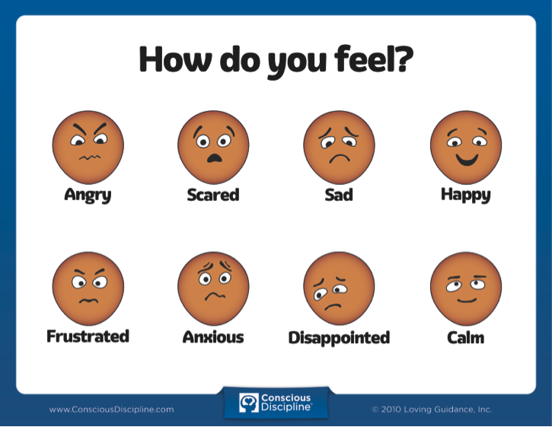
Emotional vs. Cognitive Communication
Fact-Focus/Analysis/Problem-Solving = Cognitive communication
Swearing/Defensiveness/Shut Down = Emotional communication
Be aware of your own emotional state when communicating, and try to manage it. If appropriate, name your emotions and the reasons for them to yourself and the other person(s).

Slide 43
Emotional vs. Cognitive Communication
Things that help people move out of emotional communication:
Validating emotions
Reflective Listening
Taking a walk
Taking a break from the conversation (Don’t forget to return to it later!)
Gestures of comfort, forgiveness & acceptance.

Slide 44
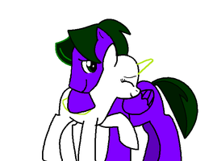
Assumptions That Aid Communication
Fundamental (not necessarily easy) Assumptions that will help communication:
Everyone is doing the best they can.
We’re all on the same team.
It isn’t personal.
“I love you.”

Slide 45
Anxiety

Slide 46
Adversity and the Stress Response
When confronted with adversity:
Adrenaline releases fight or flight response
When stress responses systems are activated in children in the context of supportive adult relationships, these physiological effects are buffered

Slide 47
Traumatic Stress and the Brain
Toxic levels of stress hormones rewire brain connections and over time can cause neuronal cell death, especially in the prefrontal cortex and limbic systems

Slide 48

How Do We Reduce Anxiety in the Moment?
Take a break (Read, take a walk, meditate, etc…)
Connect with others (Visit with family, call/text a friend, etc…)
Exercise (Take a walk/run, play a sport, lift weights, etc…)
Do the hard thing (Accept your anxiety, confront the thing that is making you anxious, build a skill, etc...)
Comforts (Snuggle under a blanket, hug a friend/family member/pet, etc…)
Escapism (Watch TV, read a book listen to music, play a game, etc…)
Anchors (Stuffed animals, a pet, a talisman, etc…)

Slide 49
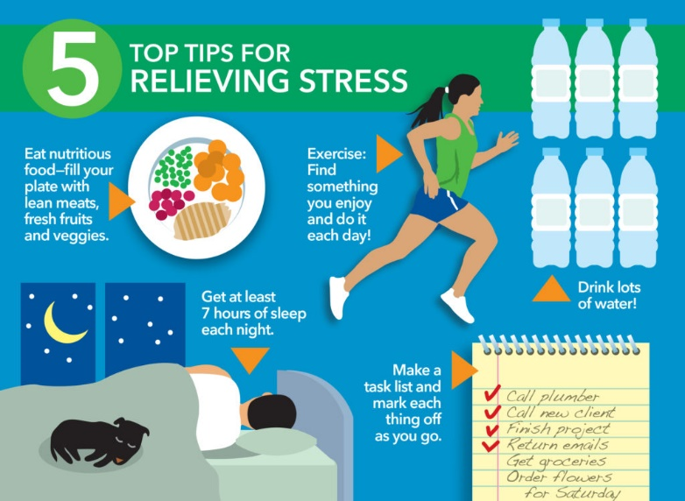
How You Can Reduce Anxiety in General
Take care of physical needs (Sleep, Diet, Exercise)
Accept your anxiety. Make friends with it.
Confront the thing that is making you anxious and do it anyway!
Learn how to be uncomfortable.
Build a skillset. Something that can help
you feel accomplished.

Slide 50

How Do We Help Others Manage Anxiety?
Allow them to use their own de-escalation strategies
Name and validate their emotions/experiences
Be as consistent as you can
Set clear & appropriate expectations
Celebrate their accomplishments
Support them in doing the hard thing

Slide 51

Self-Protection
Overall health – Diet, Sleep, Exercise
Social support – Positive / Negative / Isolation
Stress management and coping skills
Trauma/adversity (acute /chronic low-grade)

Slide 52

Next steps
Take a moment to reflect on today’s workshop.
Which of the strategies will you go away and try within the next week?

Slide 53
Any questions or comments ?

